Slide 1
CS 35L-5
Week 1 Lec 2

Slide 2
Linux Commands - Review
pipeline: |
redirection: >, >>, <
cat, grep, head, tail
Examples
cat exer1.html | grep HTML
echo “some text” > file1
cat < head -2 file1
cat < file1 >> file2
head -2 file1 | cat
cat < file1 | sort > file2

Slide 3
Process: ps and kill
Process
An instance of a computer program in execution
ps
List processes that are currently running
kill
Terminate a certain process
Usage
kill PID

Slide 4
Special Permissions
sticky bit
On shared directories, it locks files within the directory from being modified/deleted by users other than the file creator, owner of the directory, or root, even if others have write permissions (Example: /tmp)
Example:
chmod o+t /opt/dump/
-rwxr-xrwx 1 xyz xyzgroup 148 Dec 22 03:46 /opt/dump/
-rwxr-xrwt 1 xyz xyzgroup 148 Dec 22 03:46 /opt/dump/

Slide 5
diff
A file comparison utility that outputs the differences between two files.
Shows the changes between one version of a file and a former version of the same file
Usage
diff original_file new_file
diff –u original_file new_file

Slide 6
wget
A computer program that retrieves content from web servers
Usage
wget <URL>

Slide 7
Emacs
“The customizable, extensible, self documenting display editor”
Customizable (no programming)
Users can customize font, colors, etc
Extensible (programming required)
Run Lisp scripts to define new commands
Self-documenting
C-h r (manual) and C-h t (tutorial)
Cheat sheet: http://www.rgrjr.com/emacs/emacs_cheat.html

Slide 8
Getting Started
Install emacs
Should be installed already
Emacs has both GUI and CLI
All emacs commands start with “C” or “M”
“C” = ctrl; “M” = alt (Windows) / option(Mac)
Starting emacs
emacs <filename>
Exiting emacs
C-x C-c

Slide 9
Basic Editing
Insert text by simply typing it
Undo by typing C-x u
Save changes by typing C-x C-s
Copy, cut, paste
C-space (starts selecting region)
M-w (copy a region)
C-w (cuts a region)
C-k (kill a line)
C-y (yank/paste)

Slide 10
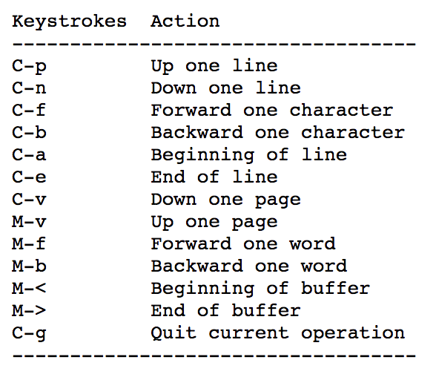
Moving around

Slide 11
Windows and Buffer
Emacs can split a frame into two or many windows. Multiple windows can display parts of different buffers, or different parts of one buffer.
C-v Scroll down (toward end of buffer)
M-v Scroll up (toward beginning of buffer)
C-M-v Scroll other window down
C-x 2 Split window vertically
C-x 3 Split window horizontally

Slide 12
The text you are editing in Emacs resides in an object called a buffer. Each time you visit a file, a buffer is used to hold the file’s text. Each time you invoke Dired, a buffer is used to hold the directory listing.
At any time, one and only one buffer is selected; we call it the current buffer.
When there are multiple windows, the buffer displayed in the selected window is current.
Minibuffer: special buffer for entering commands or input arguments to commands
*scratch* - used for evaluating Lisp expressions and is not associated with any file
Kill buffer
C-x k
Emacs as lisp interpreter
C-x b *scratch*
type (random) or (+ 1 2) or (setq x 2) then C-j
M-: and an expression to evaluate, e.g. ( * 1 2 3)

Slide 13
Directory edit (dired) (C-x d)
Creates an Emacs buffer containing list of directory contents
Allows you to operate on files
Allows you to navigate filesystem
d - select for deletion, x - actually deletes
+ - new directory, C-x C-f new file in directory
! - run shell command, e.g cat
Shift C - copy file

Slide 14
Other features
Emacs as shell
Run shell commands: M-! <command>
To run a subshell interactively, type: M-x shell
Emacs as IDE
Compile programs
M-x compile, then specify command to compile
Tip for homework: gcc hello.c –o hello
Run the executable by running the shell command
./hello

